Slide 1
The Implications of Rights of Nature for International Economic Law
Piotr Szwedo

Slide 2
Origins of Rights of Nature
Argentina
Australia
Bangladesh
Belize
Bolivia
Brazil
Canada
Colombia
Costa Rica
Ecuador
France
Guatemala
India
Mexico
New Zealand
Nigeria
Pakistan
Panama
Peru
South Africa
Spain
Uganda
United States
Premise: Nature should be a legal person with its own rights. Humans would act on its behalf.
Concept originating in postcolonial states, derived from cosmologies of indigenous people.
Introduced into wider legal debate thanks to the 1972 article “Should Trees Have Standing?” by Christopher Stone, written in reaction to the U.S. case Sierra Club v. Morton.
While currently implemented only in selected local and national legal systems, the concept tends to permeate into other jurisdictions.

Slide 3
Critique of anthropocentrism
Advocates of RoN postulate a paradigm shift, which according to them would mean changing the legal paradigm from anthropocentric to ecocentric.
Anthropocentric: focused on human beings and their needs.
Ecocentric: focused on the well-being of ecosystems.
Significance influence of theories calling for balance-of-nature, equilibrium, homeostasis of the environment.
Anthropocentrism criticised as an inherently imbalanced approach to the environment.
Need to adapt and rebalance law – another system based on equilibrium.

Slide 4
Critique of economic growth
Sustainable development remains the most popular concept calling for a balance between environmental protection, social needs, and economic development – initially closely linked to economic growth, which was measured mostly through DGP.
In the 1970s, economic growth started to be criticised on the grounds of oversimplification, but also due to the limits-to-growth challenge – the observation that infinite growth cannot be possible in a world with finite resources.
European discussions regarding degrowth/décroissance (S. Latouche, C. Taibo), postgrowth (A. Gorz), limits of growth (D.H. Meadows).
Latin American disappointment with the environmental and social impacts of neoliberal economic schools, giving rise to popularity of buen vivir / sumak kawsay – a Quechuan vision of good and harmonious life.

Slide 5
Potential issues for economic actors
While international economic law operates on a global scale, advocates for freedom of trade, supports investment and entrepreneurship, indigenous cosmologies usually on the local context, promote restrictive use of resources, privilege communities and the public sphere.
Position of economic actors may be worsened by the fact that Rights of Nature extend legal standing, facilitating strategic lawsuits.
With the state being usually the direct beneficiary of nature-focused compensation, states may be more inclined to go against some companies.
As Rights of Nature are a new legal concept, there is a considerable amount of uncertainty.

Slide 6
Burlington vs. Ecuador (ICSID 2009-2017)
Burlington Resources Inc.: a foreign investor active in oil extraction and production, allegedly causing groundwater pollution and soil contamination in Ecuadorian Amazon region.
The pollution and contamination were supposedly going on for a few years. In 2008, Ecuador adopted a new Constitution, introducing Rights of Nature as both a narrative and a normative element.
Article 10: Nature shall be the subject of those rights that the Constitution recognizes for it.
Article 71: Nature, or Pacha Mama, where life is reproduced and occurs, has the right to integral respect for its existence and for the maintenance and regeneration of its life cycles, structure, functions and evolutionary processes.
Article 72: Nature has the right to be restored. This restoration shall be apart from the obligation of the State and natural persons or legal entities to compensate individuals and communities that depend on affected natural systems.
Article 73: The State shall apply preventive and restrictive measures on activities that might lead to the extinction of species, the destruction of ecosystems and the permanent alteration of natural cycles.
Article 397: incl. e.g. principle of immediateness & actio popularis even on precautionary grounds.
Ecuador used RoN as a justification of a strict liability regime, with Burlington arguing that it cannot be applied retroactively.
Expropriation of Burlington was considered unlawful and new constitutional provisions could not be applied retroactively, but Ecuador was awarded some compensation in counterclaims.

Slide 7
EC — Seal Products (WTO Dispute Settlement 2011-2014)
In 2009, the Trade in Seal Products Basic Regulation of the European Parliament and Council prohibited the placing of seal products on the EU market, with the exception of products resulting from traditional hunting by the Inuit people.
The panel found that this exception violates Article I:1 of the GATT 1994, as it treats the Inuit products (from Greenland) in a different way than like products from other countries.
The exception was changed to include “Inuit and other indigenous communities”.
According to the EU, seal hunts traditionally conducted by the Inuit and other indigenous communities contribute to the subsistence of these communities and as such do not raise the same public moral concerns as seal hunts conducted primarily for commercial reasons.
An “indigenous exception” is based on proportionality (scale), necessity (means of subsistence), and culture (tradition), while being quite distant from the logic of any absolute rights belonging to particular seals.
The dispute did not involve explicit references to Rights of Nature, but it illustrates similar thought patterns (respect for indigenous practices, protection of ecosystems as a whole).

Slide 8
Final remarks
Rights of Nature seem to play more a political and symbolic role in proceedings; their legal content remains to be precisely determined.
Rights of Nature may have an impact on states’ shrinking willingness to accept certain categories of economic activities.
Differences in legal systems are bound to influence the behaviour of actors in cases involving transboundary risks.
Rights of Nature and connected concepts, even if adopted by a minority of states, may cause a shift in investment decisions and policies.
The moral and cultural underpinnings are often closely linked to the local context of particular states and might not translate well into international and European economic law.
The Rights of Nature discourse lacks discussions about balance between the social, economic, and environmental considerations.

Slide 9
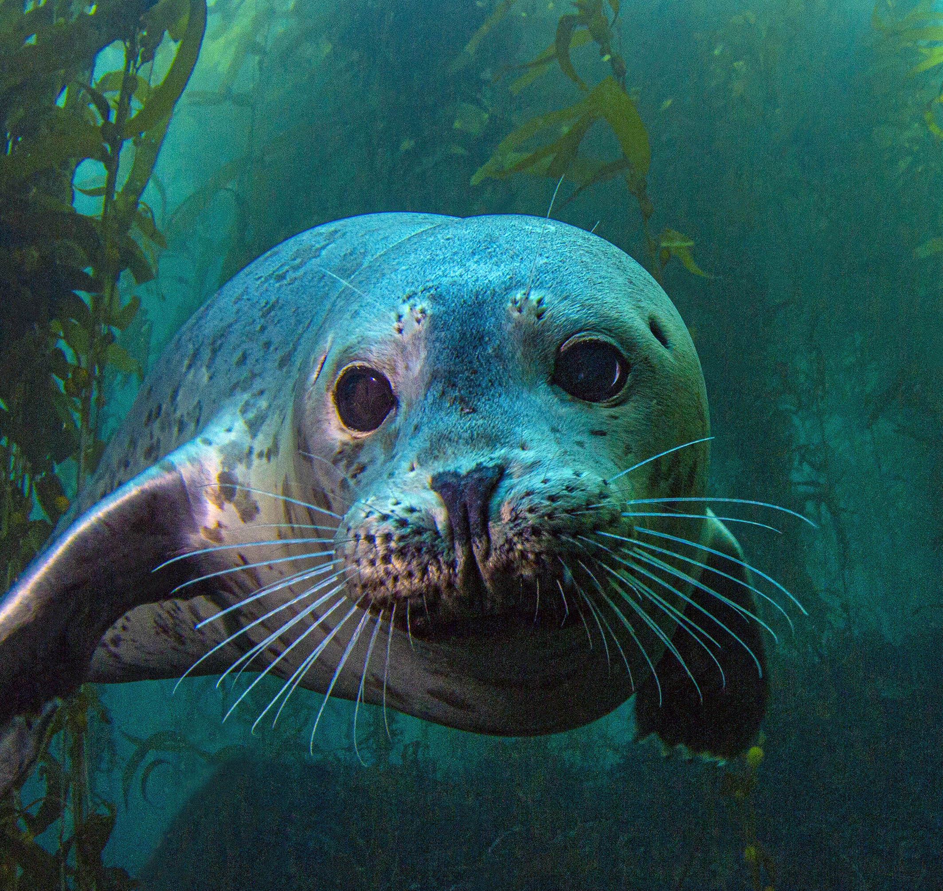
Thank you!

